Slide 1
Motorized Dobsonian Telescope Senior Project
Nathan Wiley

Slide 2
Goal:
Lightweight
Motorized
Coordinate tracking
Remote Operation
Mechanism to switch eyepiece

Slide 3
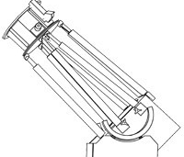
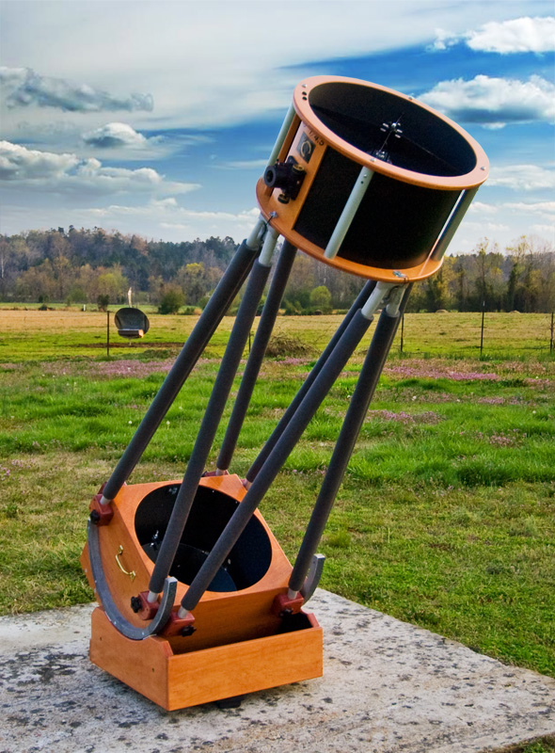
Design:
Steady base
Microprocessor controlling
Altitude motor and rotary encoder
Azimuth motor and rotary encoder
Coordinate tracking
Networked computer controlling
Star and coordinate data fetching
Image processing
Command interface

Slide 4
Potential Problems
Frame not being finished in time
Issues getting microprocessor to work with the motors
Issues getting coordinates and database to work properly

Slide 5
Resolutions:
Working on frame over Summer
Choosing the right database for coordinates

Slide 6
Budget Estimation:
Part | Price | Link
304mm f/5 Primary Mirror (Already purchased) | $590.00 | https://agenaastro.com/gso-parabolic-primary-telescope-mirror-12-f-5-ad017.html
70mm Elliptical Secondary Mirror | $82.00 | https://agenaastro.com/gso-elliptical-secondary-mirror-70-mm.html
2x Stepper motors | ~$200.00 | -
Frame Materials | ~$200.00 | -
Eyepieces | $189.95 | https://www.adorama.com/cnak.html

